Slide 1
Exploratory project
Presented by : Nooka Jathin Swaroop
Roll no:23065072
Department: Civil engineering
Date:06-05-2025

Slide 2
“GNSS Applications in Earthquake Monitoring”
Introduction: GNSS (Global Navigation Satellite System) helps in monitoring and detecting early signs of earthquakes rather than directly predicting them. Scientists use GNSS data to track ground deformations that may indicate stress buildup in the Earth's crust. Here’s how GNSS contributes to pre-earthquake detection:

Slide 3
1)Importance of GNSS in geophysical Studies
Importance of GNSS in Geophysical Studies
Precise Positioning: GNSS (Global Navigation Satellite Systems) provides centimeter-level accuracy in positioning, essential for monitoring Earth's surface movements.
Crustal Deformation Monitoring: It helps detect slow and subtle shifts in the Earth's crust, useful in tectonic and volcanic studies.
Real-Time Observations: Enables continuous monitoring of geological processes over time.
Wide Area Coverage: GNSS networks cover large geographic areas, offering consistent data across regions.

Slide 4
How GNSS Helps in Earthquake Detection?
Detects Ground Displacement: GNSS stations capture pre-, co-, and post-seismic shifts in position due to tectonic stress and fault ruptures.
Early Warning Systems: Real-time GNSS data can feed into early warning systems, improving disaster preparedness.
Monitoring Tectonic Plate Movements
GNSS stations track crustal deformations by measuring changes in coordinates over time.
If two tectonic plates are locked, stress builds up, which can lead to an earthquake.
Scientists analyze GNSS data to study how stress accumulates and to assess earthquake risks.

Slide 5
How GNSS Helps in Earthquake Detection?
To explore the application of GNSS technology in earthquake monitoring. The project aims to demonstrate how GNSS systems can detect crustal displacement caused by seismic activity.

Slide 6
Case study: Turkey Earthquake 2023
The February 6, 2023, Turkey earthquake was a high-magnitude (Mw 7.8) event with severe structural and geological impact, providing a valuable case for GNSS analysis.
GNSS stations like MERS in the region provided available RINEX data, which made scientific analysis feasible and accurate.
The event gained international research interest, allowing the project to be compared with global findings and validated through multiple data sources.

Slide 7
GNSS and Earthquake Monitoring
GNSS applications in seismic deformation:
Tracks tectonic plate movement in real-time
Monitors stress accumulation and release along fault lines
Helps assess permanent crustal deformation

Slide 8
How GNSS tracks crustal movement:
Compares precise GNSS coordinates over time
Detects millimeter-level shifts using high-accuracy post-processing
Useful for detecting both pre- and post-earthquake displacement

Slide 9
3. Data Collection and Tools Used
RINEX file sources:
Downloaded from GNSS stations near the epicenter (e.g., MERS)
Data includes satellite observations in standardized format.
AUSPOS processing workflow:
Submit RINEX files to AUSPOS (Geoscience Australia)
Receive precise ITRF coordinates in X, Y, Z and ENU
Compare before and after data to measure displacement

Slide 10
Coordinate Systems Explanation
Submitting Rinex files to Auspos.
Upload daily GNSS observation file.
Specify station name and antenna details.
Interpreting coordinate shifts
Movement in X/Y indicates horizontal displacement
Change in Z or Up component reveals vertical movement
Combine components to compute total displacement vector

Slide 11
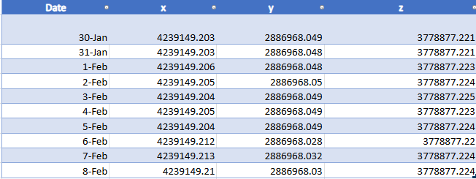
Observations of x,y,z coordinates from Auspos

Slide 12
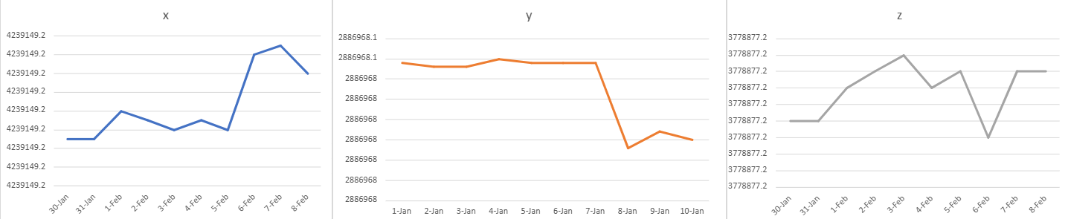
X,Y,Z Graphs

Slide 13
Conclusion from X, Y, Z Graphs:
Conclusion from X, Y, Z Graphs:
Sudden Shift in Coordinates:
The graphs show an abrupt change (or jump) in the X, Y, and/or Z values on or immediately after the earthquake date (Feb 6, 2023).
This indicates sudden ground displacement due to seismic activity.
The GNSS station did not return to its original position after the quake.
This confirms permanent crustal deformation, not just temporary shaking.

Slide 14
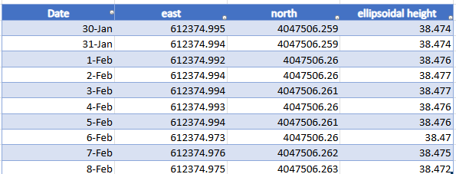
Observations of east,north,ellipsoidal height.

Slide 15
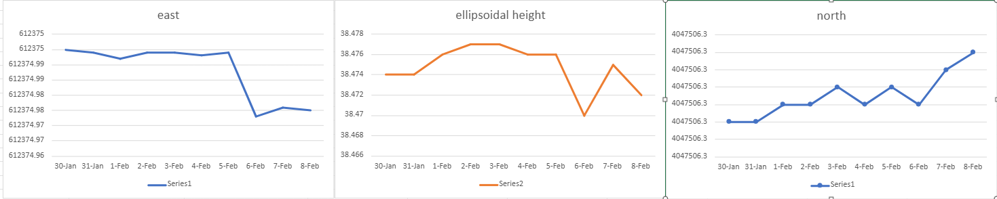
Graphs of East,North,Ellipsoidal height

Slide 16
Conclusion
Key findings:
GNSS is effective in detecting earthquake-induced displacement
AUSPOS analysis confirms measurable movement at MERS station
So,Gnss can not accurately predict earthquake before because occurs sudden change in displacement due to stress accumulation causes earthquake.
Gnss more helpful for real time analysis after the earthquake for rescue operations.

